Slide 1





Project
Notes:
https://unsplash.com/photos/AXu2aZ3YgP8

Slide 2
Encoding Table

Slide 3

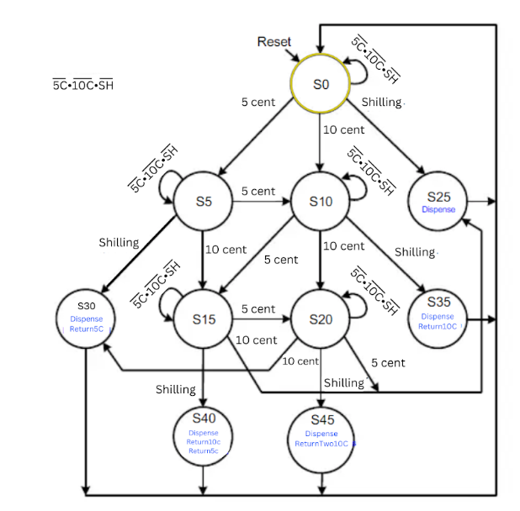
Notes:
https://unsplash.com/photos/fItRJ7AHak8

Slide 4
FST TABLE

Slide 5
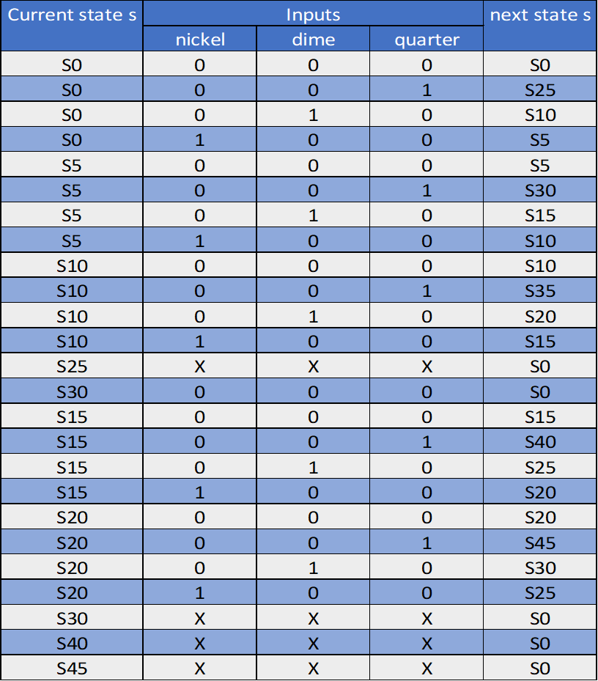
c u r r e n t s t a t e s | i n p u t s |  |  | n e x t s t a t e s '
 | n i c k e l | d i m e | q u a r t e r
0000000001 | 0 | 0 | 0 | 0000000001
0000000001 | 0 | 0 | 1 | 0000001000
0000000001 | 0 | 1 | 0 | 0000000100
0000000001 | 1 | 0 | 0 | 0000000010
0000000010 | 0 | 0 | 0 | 0000000010
0000000010 | 0 | 0 | 1 | 0000010000
0000000010 | 0 | 1 | 0 | 0000100000
0000000010 | 1 | 0 | 0 | 0000000100
0000000100 | 0 | 0 | 0 | 0000000100
0000000100 | 0 | 0 | 1 | 0010000000
0000000100 | 0 | 1 | 0 | 0001000000
0000000100 | 1 | 0 | 0 | 0000100000
0000001000 | X | X | X | 0000000001
0000010000 | X | X | X | 0000000001
0000100000 | 0 | 0 | 0 | 0000100000
0000100000 | 0 | 0 | 1 | 0100000000
0000100000 | 0 | 1 | 0 | 0000001000
0000100000 | 1 | 0 | 0 | 0001000000
0001000000 | 0 | 0 | 0 | 0001000000
0001000000 | 0 | 0 | 1 | 1000000000
0001000000 | 0 | 1 | 0 | 0000010000
0001000000 | 1 | 0 | 0 | 0000001000
0010000000 | X | X | X | 0000000001
0100000000 | X | X | X | 0000000001
1000000000 | X | X | X | 0000000001
Notes:
https://unsplash.com/photos/48nerZQCHgo

Slide 6
Output Table

Slide 7
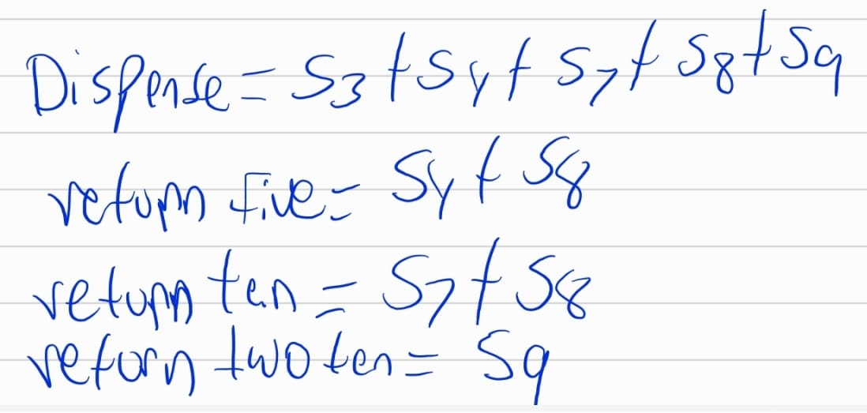
Notes:
https://unsplash.com/photos/TvN54bnuQg8

Slide 8
Equations and Circuits

Slide 9
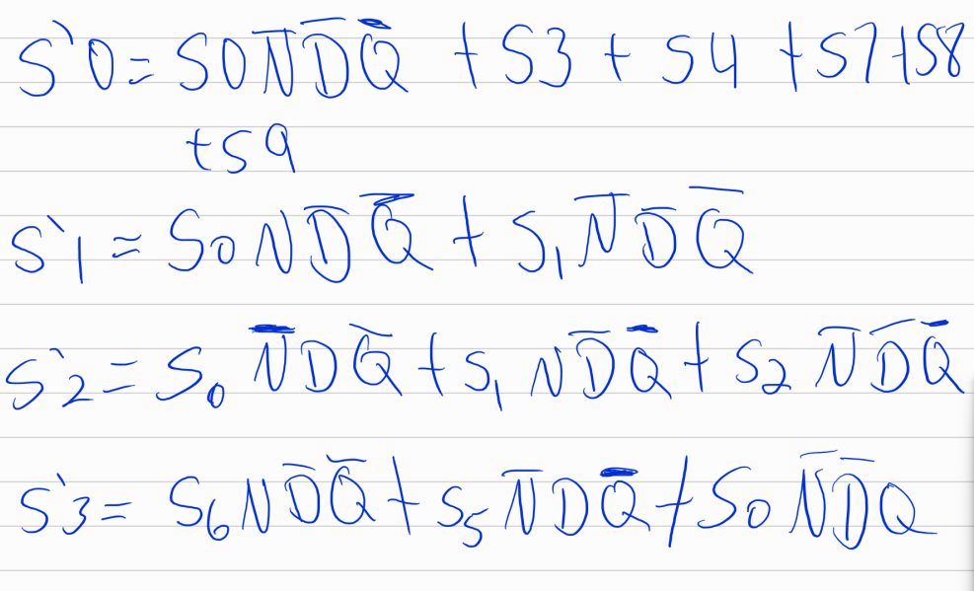
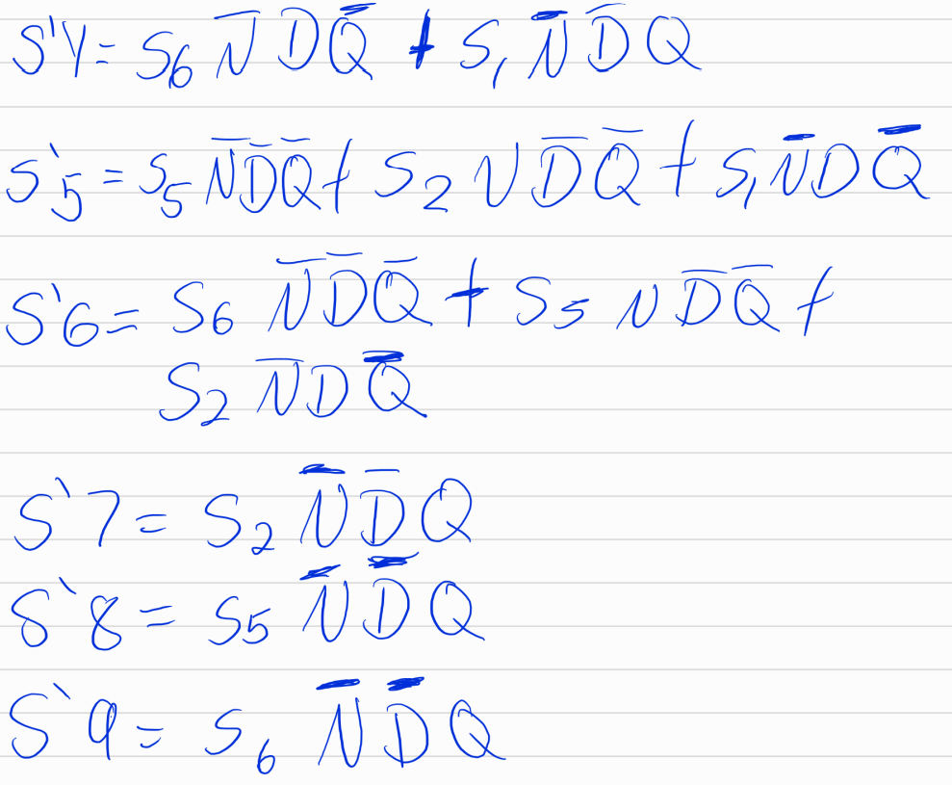
Notes:
https://unsplash.com/photos/GKLIsLZxhj0

